Slide 1
GAN Applications

Slide 2
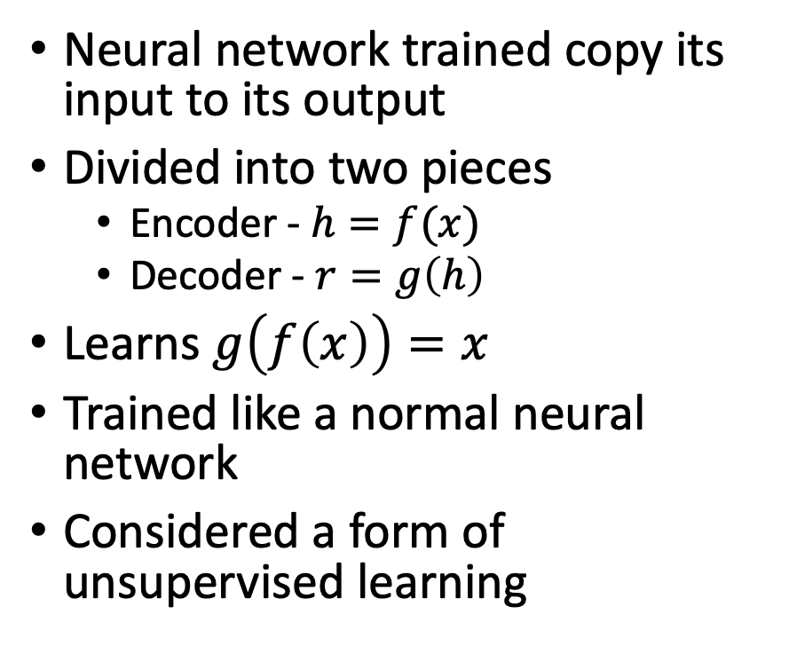
Review - Autoencoders
Neural network trained copy its input to its output
Divided into two pieces
Encoder - $h=f(x)$
Decoder - $r=g\left(h\right)$
Learns $g\left(f\left(x\right)\right)=x$
Trained like a normal neural network
Considered a form of unsupervised learning

Slide 3
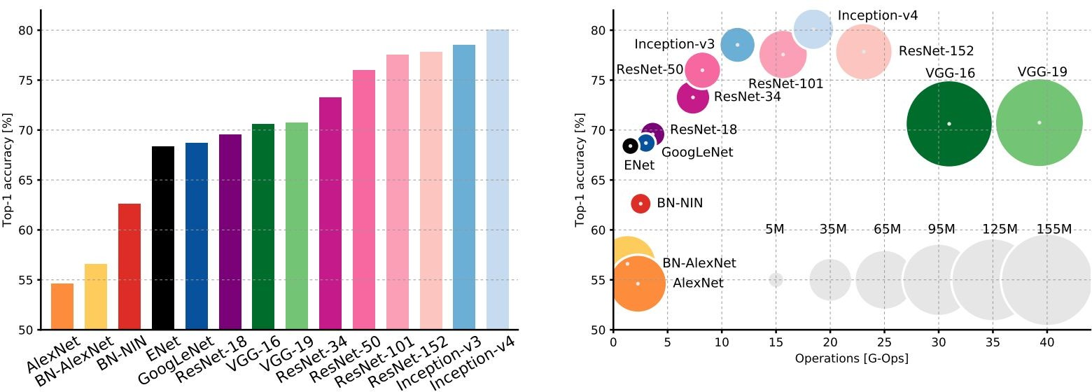
Review – Model Architectures
An Analysis of Deep Neural Network Models for Practical Applications, 2017.
Figures copyright Alfredo Canziani, Adam Paszke, Eugenio Culurciello, 2017. Reproduced with permission.
Fei-Fei Li & Justin Johnson & Serena Yeung Lecture 9 - April 30, 2019

Slide 4
Unsupervised Representation Learning with Deep Convolutional Generative Adversarial Networks (2015)
Similar Generator/Discriminator architecture to GAN

Slide 5
Unsupervised Representation Learning with Deep Convolutional Generative Adversarial Networks (2015)

Slide 6
Unsupervised Representation Learning with Deep Convolutional Generative Adversarial Networks (2015)

Slide 7
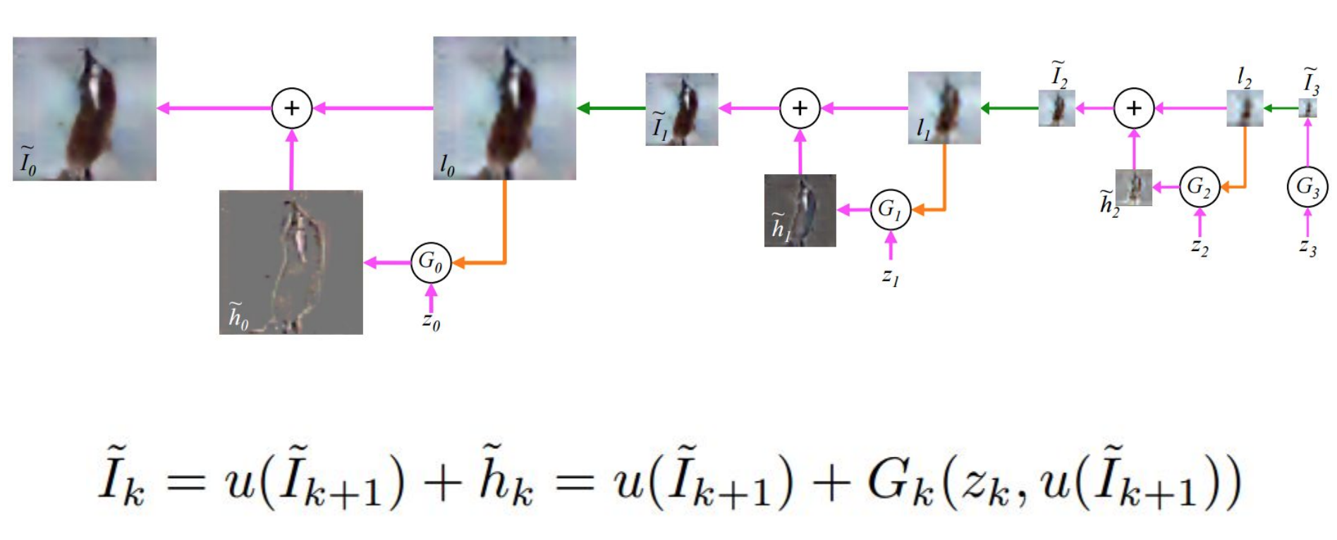
Laplacian Pyramid Generative Adversarial Network

Slide 8
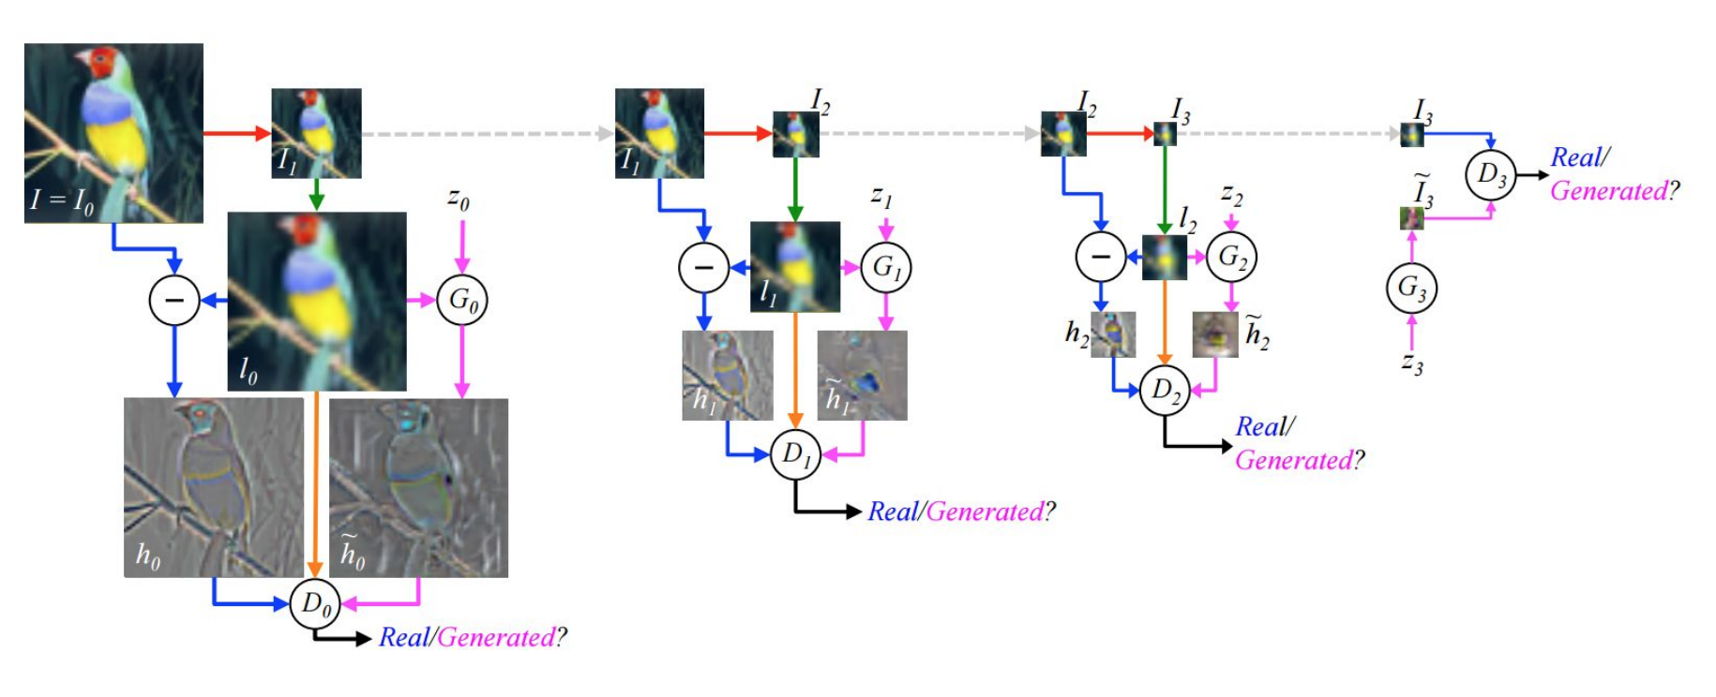
Laplacian Pyramid Generative Adversarial Network

Slide 9
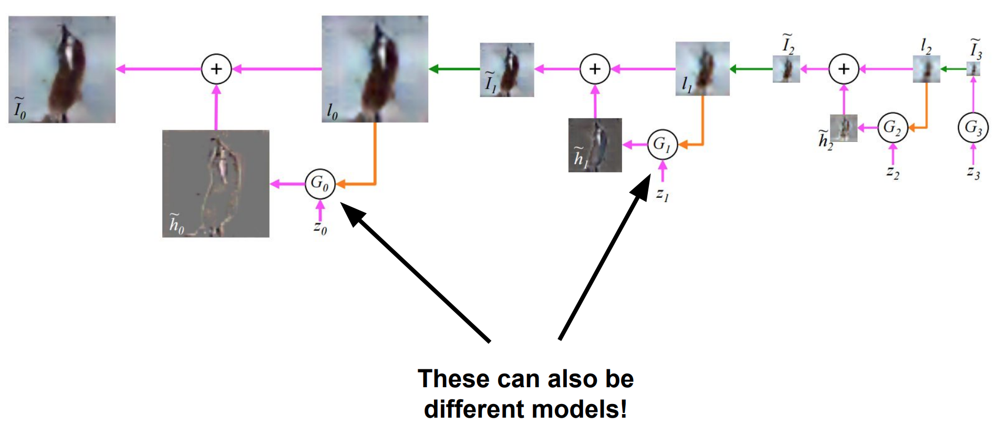
Laplacian Pyramid Generative Adversarial Network

Slide 10
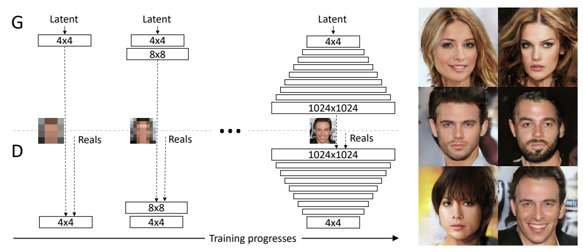
Progressive Growing of GANs for Improved Quality, Stability, and Variation
Notes:
The generation of high-resolution images is difficult because higher resolution makes it easier to tell the generated images apart from training images (Odena et al., 2017), thus drastically amplifying the gradient problem. Large resolutions also necessitate using smaller minibatches due to memory constraints, further compromising training stability. Our key insight is that we can grow both the generator and discriminator progressively, starting from easier low-resolution images, and add new layers that introduce higher-resolution details as the training progresses. This greatly speeds up training and improves stability in high resolutions

Slide 11
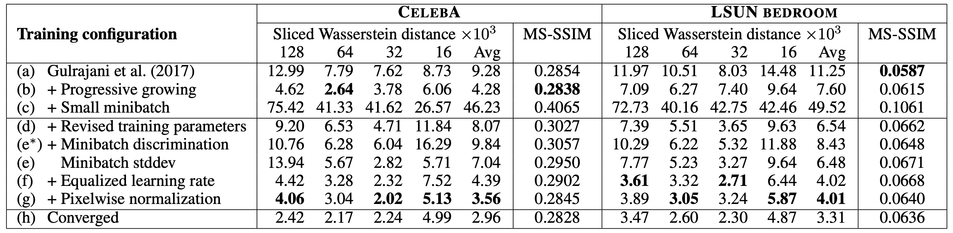
Progressive Growing of GANs for Improved Quality, Stability, and Variation
https://www.youtube.com/watch?v=G06dEcZ-QTg&feature=youtu.be

Slide 12
Progression of GAN Quality

Slide 13
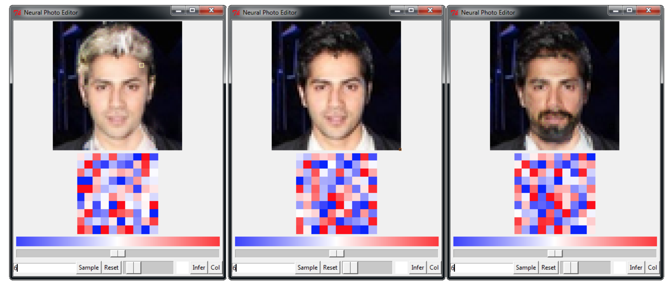
Neural Photo Editing with Introspective Adversarial Networks
Notes:
The Neural Photo Editor. The original image is center. The red and blue tiles are visualizations of the latent space, and can be directly manipulated as well.

Slide 14
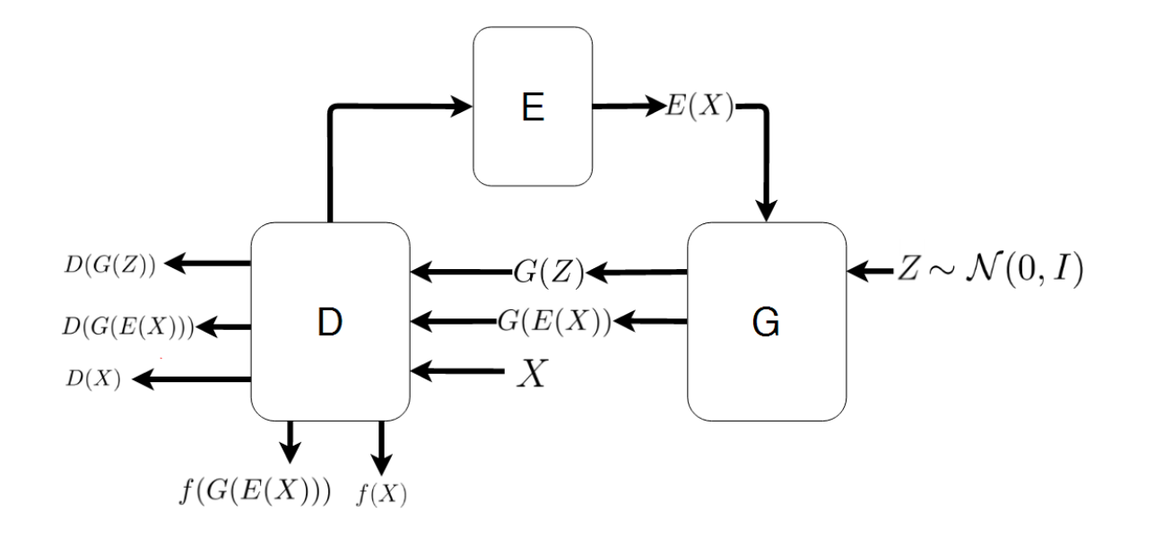
Neural Photo Editing with Introspective Adversarial Networks
Notes:
Introspective Adversarial Network Architecture
Relies on autoencoder and GAN together. Latent space is shared between the GAN and autoencoder.
E – encoder
G – generator and decoder
D – Discriminator
Loss function becomes complex – reconstruction error, combined with ternary GAN loss (real, fake, reconstructed)

Slide 15
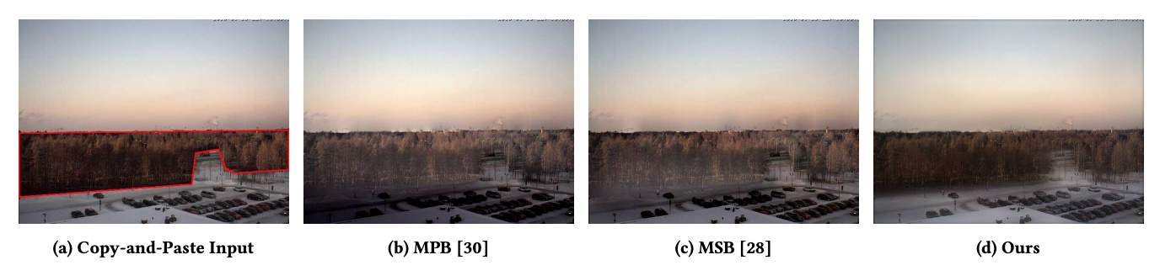
GP-GAN Towards High-Resolution Image Editing

Slide 16
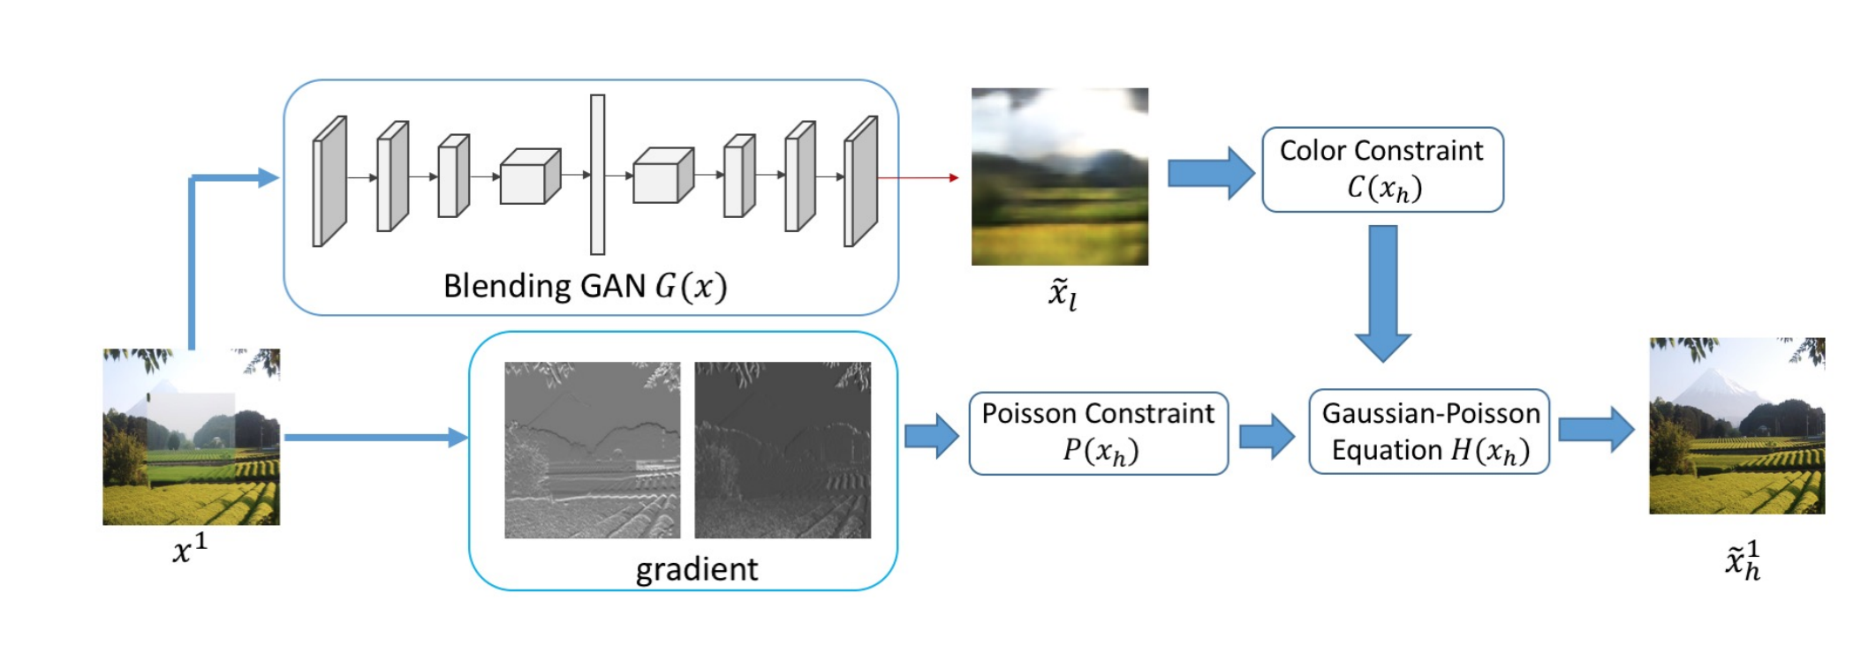
GP-GAN Towards High-Resolution Image Editing

Slide 17
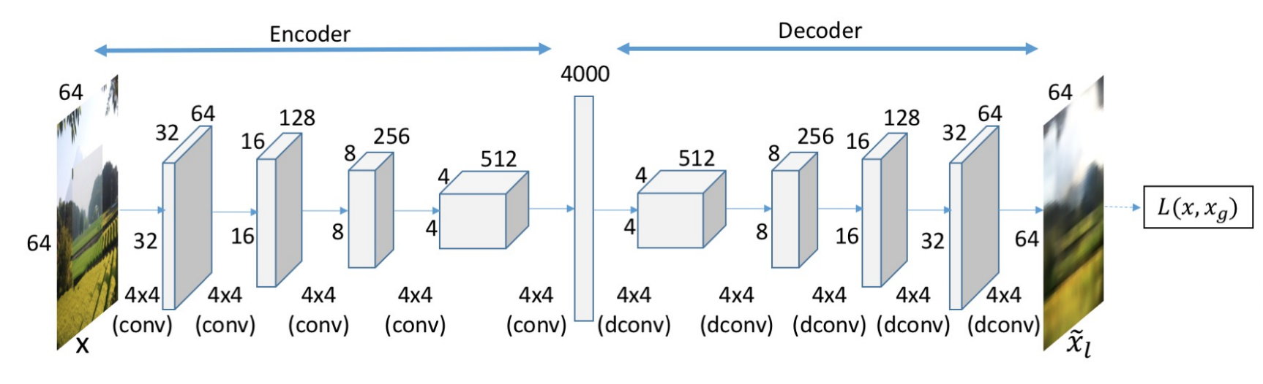
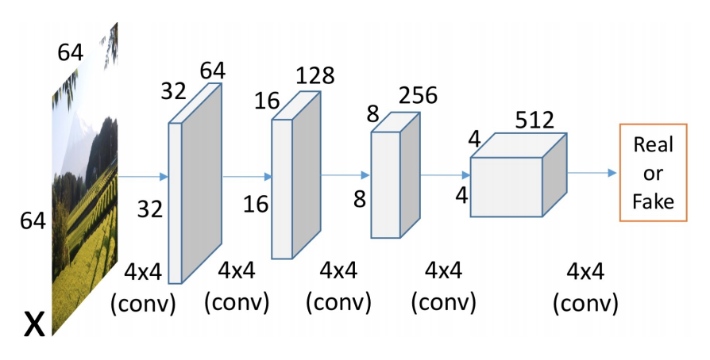
GP-GAN Towards High-Resolution Image Editing

Slide 18
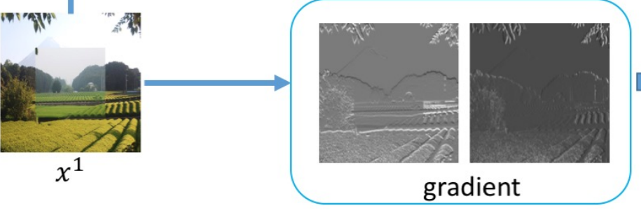
GP-GAN Towards High-Resolution Image Editing
By Cmglee - Own work, CC BY-SA 3.0, https://commons.wikimedia.org/w/index.php?curid=42549151

Slide 19
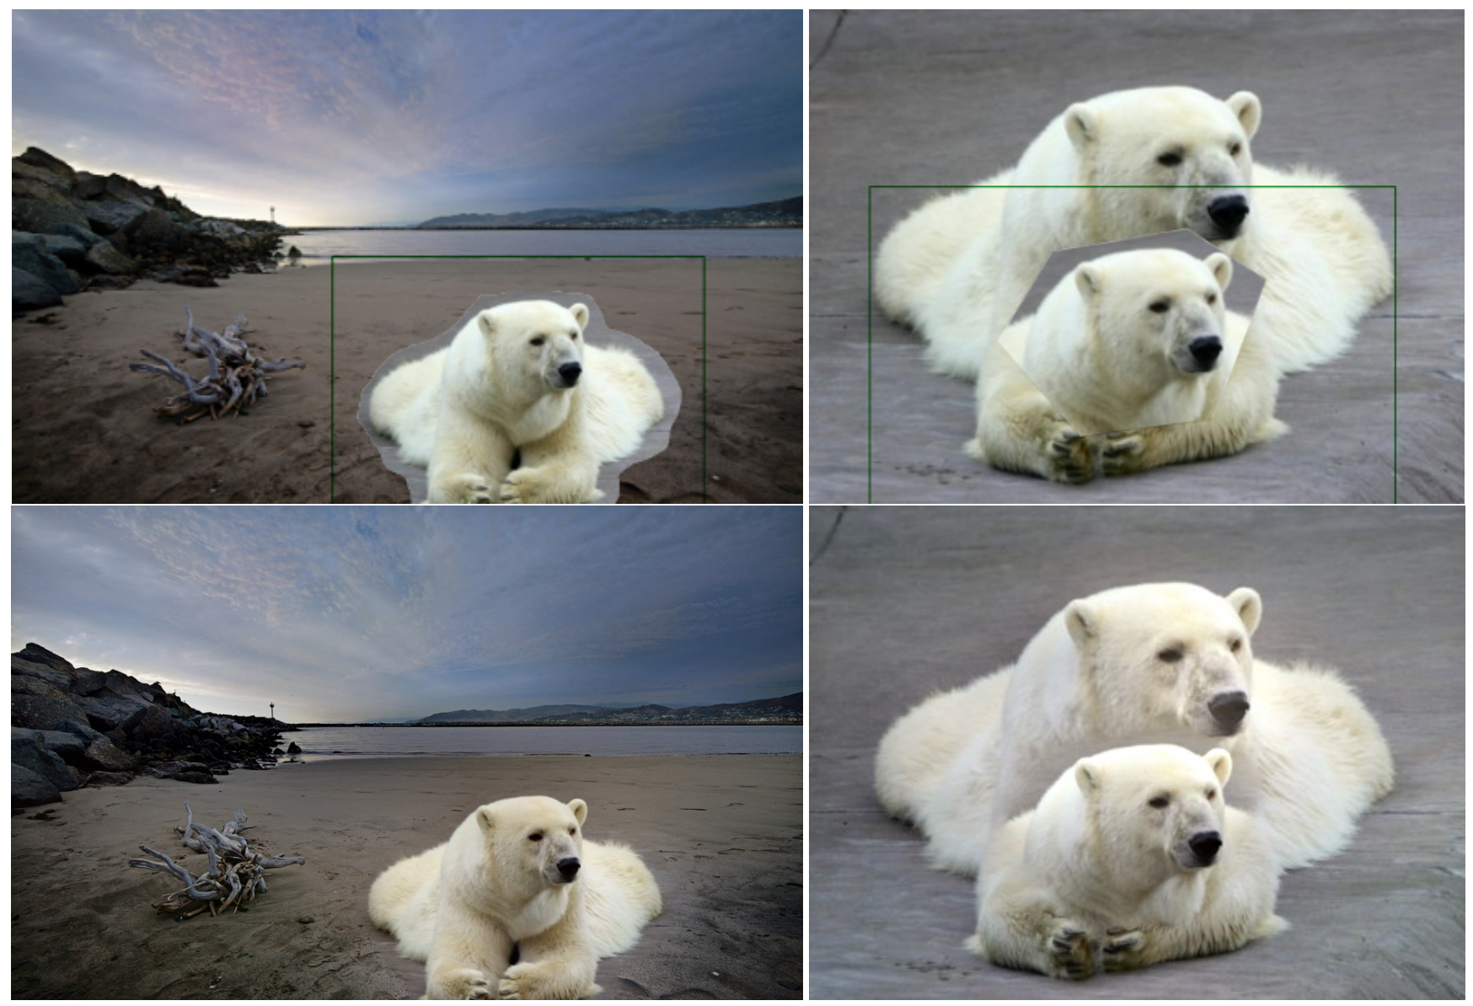

Slide 20
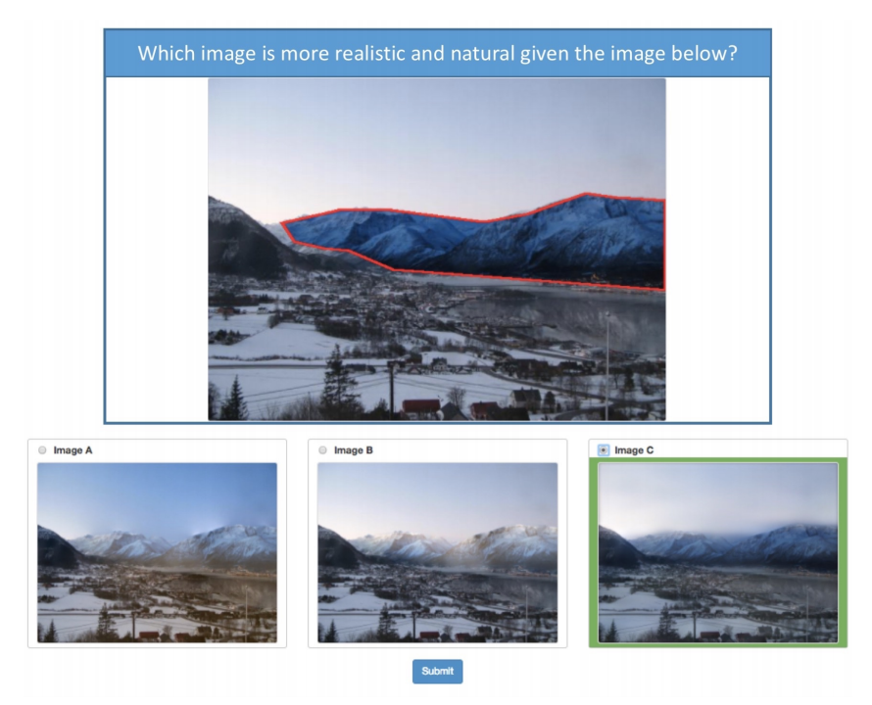
GP-GAN Towards High-Resolution Image Editing

Slide 21
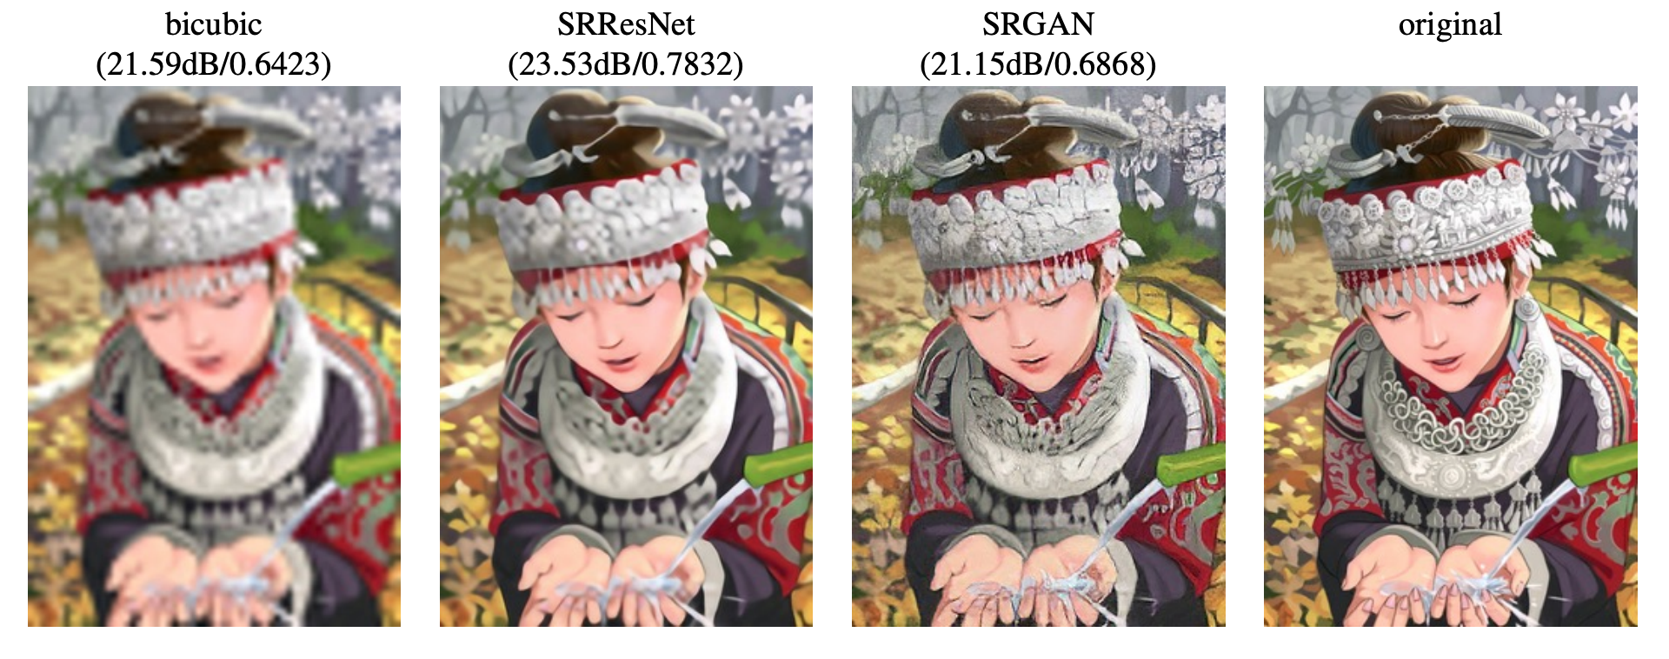
Photo-Realistic Image Super-Resolution Using a Generative Adversarial Network

Slide 22
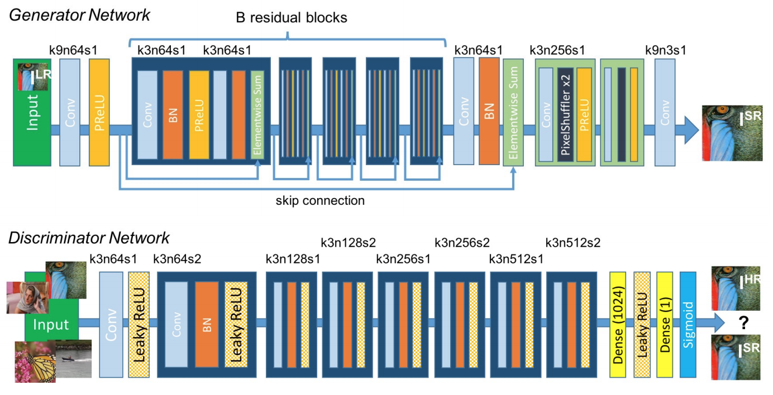
Photo-Realistic Image Super-Resolution Using a Generative Adversarial Network

Slide 23
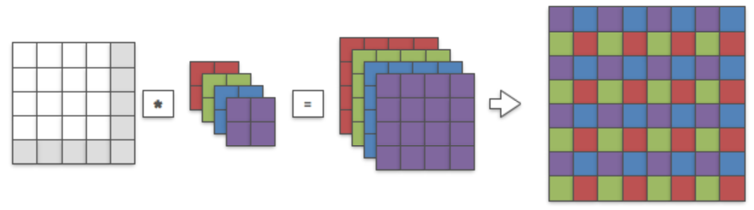
Photo-Realistic Image Super-Resolution Using a Generative Adversarial Network

Slide 24
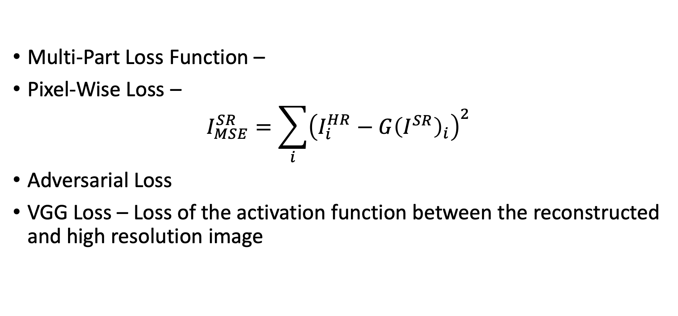
Photo-Realistic Image Super-Resolution Using a Generative Adversarial Network
Multi-Part Loss Function –
Pixel-Wise Loss –
$$I_{MSE}^{SR}=\sum_{i}{{\left(I_{i}^{HR}−G{\left(I^{SR}\right)}_{i}\right)}^{2}}$$
Adversarial Loss
VGG Loss – Loss of the activation function between the reconstructed and high resolution image

Slide 25
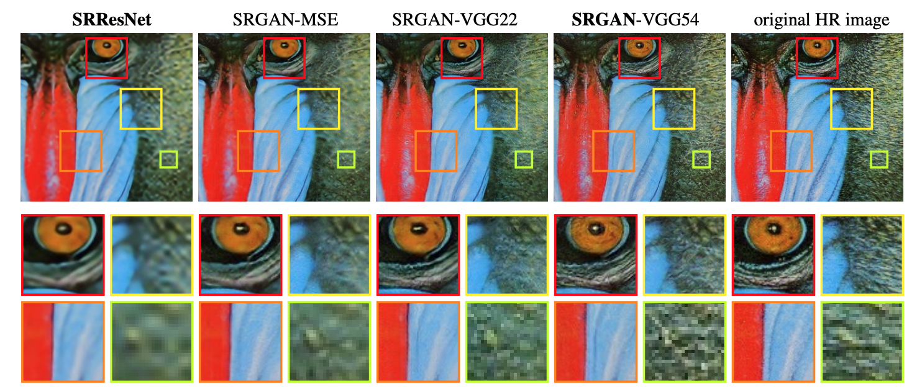
Photo-Realistic Image Super-Resolution Using a Generative Adversarial Network

